Slide 1
SNAKE AI GAME
Group Members:
NAME | MATRIC NUMBER
Amrita Nambiar | 17173025/1
Eng Kah Hui | 17184031/1
Athar Bagunaid | 17083073/1
Dong Yirui | 17102165/1

Slide 2
TABLE OF CONTENTS
01
02
03
04
05
06
ENVIRONMENT & SIMULATION
PROBLEM DEFINITION
RELATED WORK
PROPOSED APPROACH
POSSIBLE EXPERIMENTS
INITIAL RESULTS

Slide 3
Problem Definition
Simple strategies may keep the snake alive, however, without it making efficient decisions to move toward the apples, it would not be able to perform well.
The application of genetic algorithm and neural network in developing a controller with artificial intelligence.
Both of the algorithms are effective for AI gaming
The achievement of highest score possible for game by AI gaming techniques.
E.g. In this game, it is to achieve as high score as possible while keeping the snake alive.

Slide 4
Related Work
Best First Search (Sharma et al., 2019)
This Greedy Best-First Search algorithm has a one-move horizon and only considers moving the snake to the position on the board that appears to be closest to the goal, i.e. apple. They use Manhattan distance to define how close the snake head is to the apple.
This method has almost guaranteed that the snake will be able to eat in an optimal (shortest) way at least the first four apples. However, the one-step horizon also makes it easy to get stuck on local minima and plateaus.
Notes:
Sharma, S., Mishra, S., Deodhar, N., Katageri, A., & Sagar, P. (2019, December). Solving The Classic Snake Game Using AI. In 2019 IEEE Pune Section International Conference (PuneCon) (pp. 1-4). IEEE.

Slide 5
Related Work
A* search (Sharma et al., 2019)
A* incorporates a heuristic in a multiple move horizon. Before taking action, it considers not only where the goal is and how far it is, but also the current state it has searched so far.
This A∗ algorithm uses the Manhattan distance from the head to the apple as a heuristic and the number of steps as the “cost so far”. Each iteration of the algorithm lasts until a path is found that leads the snake to eat an apple. It improves the Best First Search algorithm by finding a full path to the apple and not stopping at the first move, this has the advantage of not getting stuck at a dead end on the way to the apple.
The algorithm is guaranteed to find an optimal path to the apple if one exists, only when there is no memory or time restrictions.
Notes:
Sharma, S., Mishra, S., Deodhar, N., Katageri, A., & Sagar, P. (2019, December). Solving The Classic Snake Game Using AI. In 2019 IEEE Pune Section International Conference (PuneCon) (pp. 1-4). IEEE.

Slide 6
Related Work
Reinforcement Learning (Deep Q-Learning) (Almalki and Wocjan, 2019)
The Deep Reinforcement Learning model enables the autonomous agent to play the Snake Game. In Reinforcement Learning, there are two main components: the environment(game) and the agent(snake). Every time the agent performs an action, the environment gives a reward to the agent, which can be positive or negative depending on how good the action was from that specific state. The goal of the agent is to learn what actions maximize the reward, given every possible state.
However, the naive reward mechanism of DQN only produces sparse and delayed rewards that may lead to ineffective learning of correct policies.
Notes:
Almalki, A., & Wocjan, P. (2019, December). Exploration of Reinforcement Learning to Play Snake Game. In 2019 International Conference on Computational Science and Computational Intelligence (CSCI) (pp. 377-381). IEEE.

Slide 7
Environment & Simulation
The game environment is a 20x20 map
There are boundaries with left, right, top and bottom
The snake has to move up and down from right to the left without touching the boundaries
When the snake is close to the leftmost boundary, it will go back to rightmost boundary along last row
The process repeats until it is out of options
The snake has to avoid hitting its own body or the wall
The snake has to eat apples
The length of snake increases as it eats

Slide 8
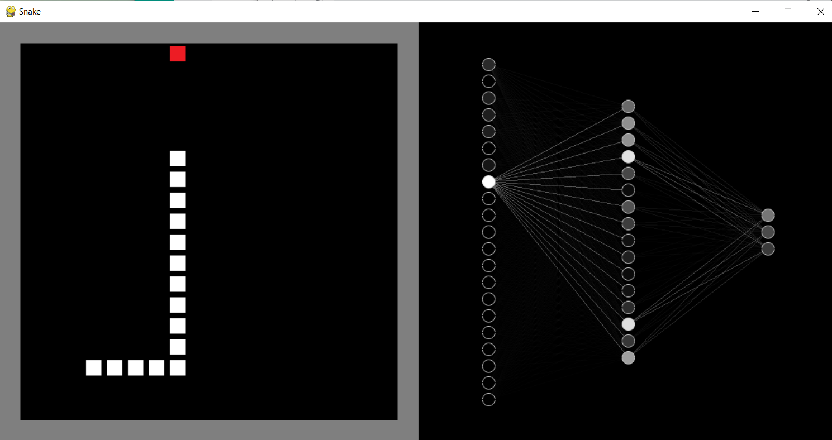
Simulation

Slide 9
Proposed Approach
Using a neural network & genetic algorithm, each population of snakes will slowly learn how to play the game
The neural network has:
- 1 input layer: Inputs for the network (Snake's vision)
- 1 hidden layer: Learning layer
- 1 output layer: Moving direction of snake (Straight, Left, Right)
Takes an input vector and calculate the output by propagation through the network
Purpose of Genetic Algorithm: Train the network

Slide 10
Proposed Approach
Steps at each generation (*generation_number=100* population size =1000 per generation) :
1- Parents selection
2- Offsprings production
3- Mutated individuals production
4- Evaluation of whole population (old population + offsprings + mutated individuals)
5- Additional mutations on random individuals
6- Keeping only *population_size=1000* individuals, throwing bad performers

Slide 11
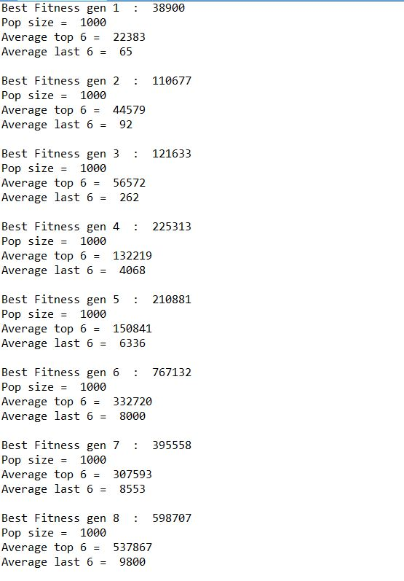
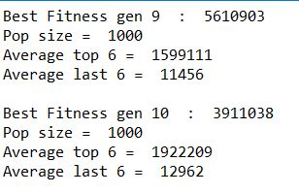
Initial Results

Slide 12
Possible Experiments
We try to play with the parameter values in order to achieve different results. However, due to the long training time, we decided to focus on the changing the crossover and mutation rates.
Initially, the generations were trained using very low crossover rate 0.3 and very high mutation rate 0.7. However, this result in more random generation instead of consistent development from one generation to another.
As a result we decided to train our generations with crossover rate of 0.7 and mutation rate of 0.01.
The following slides will show the result of fitness of our generations

Slide 13
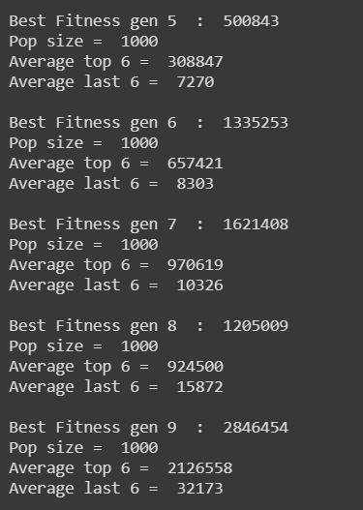
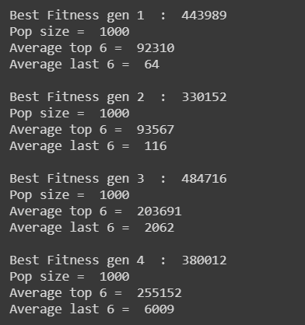
Our Results

Slide 14
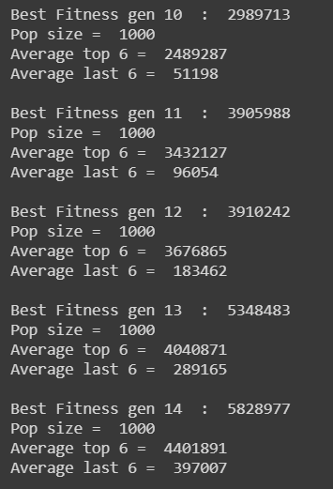
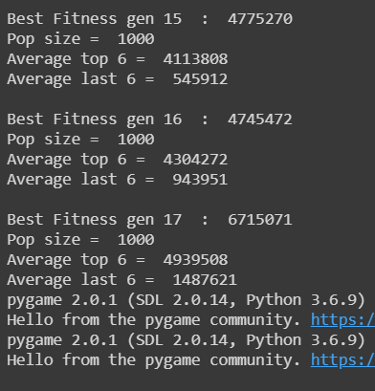
Our Results

Slide 15
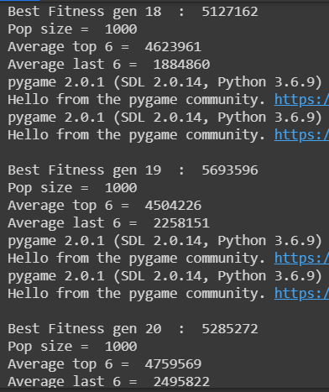
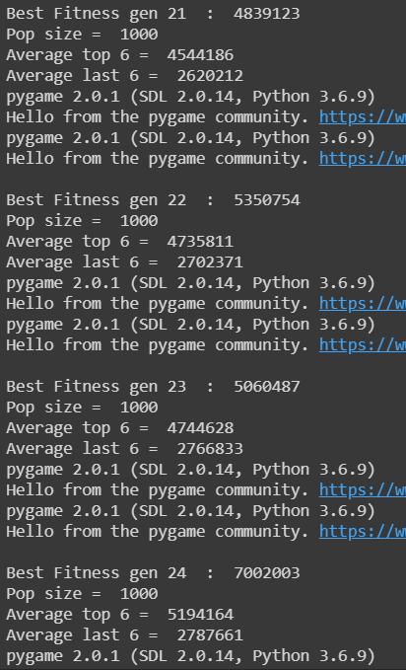
Our Results

Slide 16
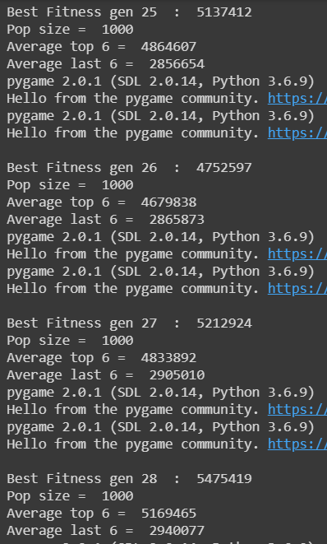
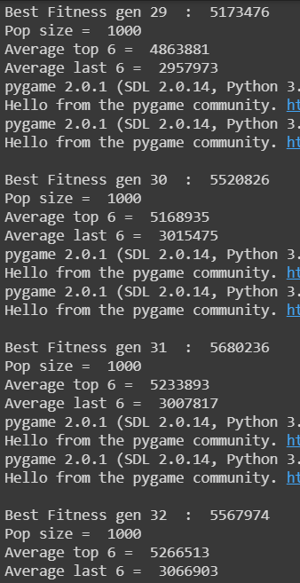
Our Results

Slide 17
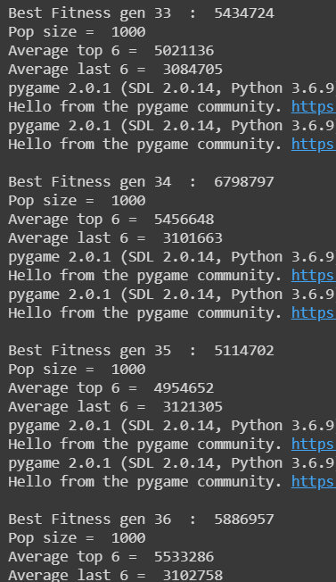
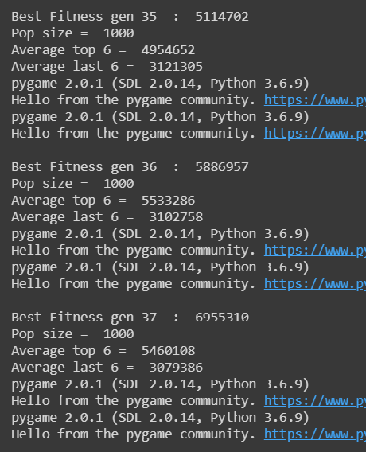
Our Results

Slide 18
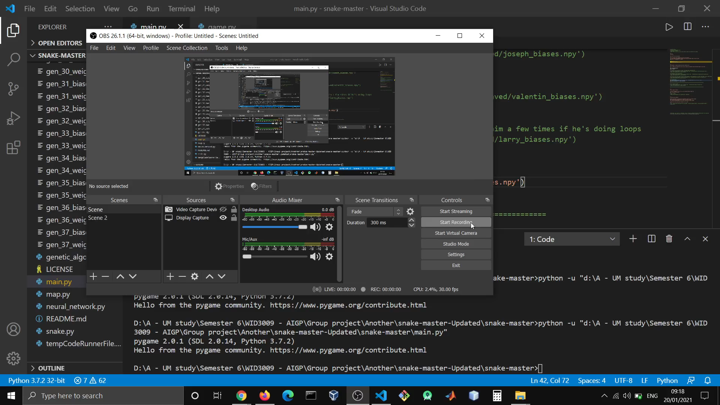
Our Demo

Slide 19
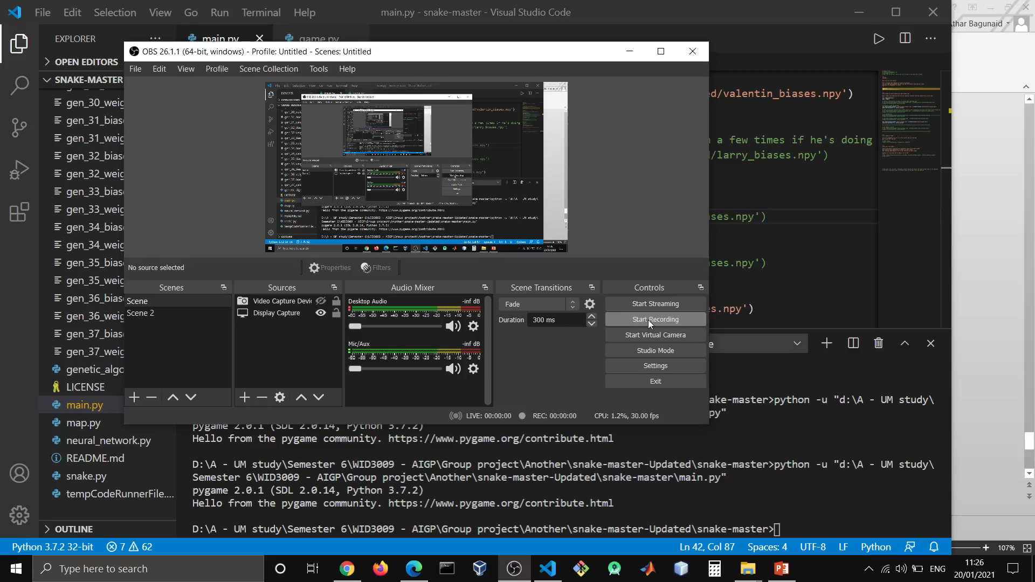
Our Demo

Slide 20
THANKS

